Slide 1
Integration through Legal Hacking Methods
Farrokh Alemi, PhD

Slide 2
This is not about …
Disclaimer
2 free clinics using cloud based EHR
~ 30 primary care clinics in Virginia

Slide 3
This was not done …
Disclaimer
By 2 research teams
at GMU, Health Informatics

Slide 4
One of the teams was not supported by external research funds
Disclaimer

Slide 5
And I am not here
Disclaimer

Slide 6

Problem
1/3 vendors don’t or can’t participate
Personal health records can’t get updated
Date exchanges face formidable barriers
Quality data missing, distorted, …

Slide 7
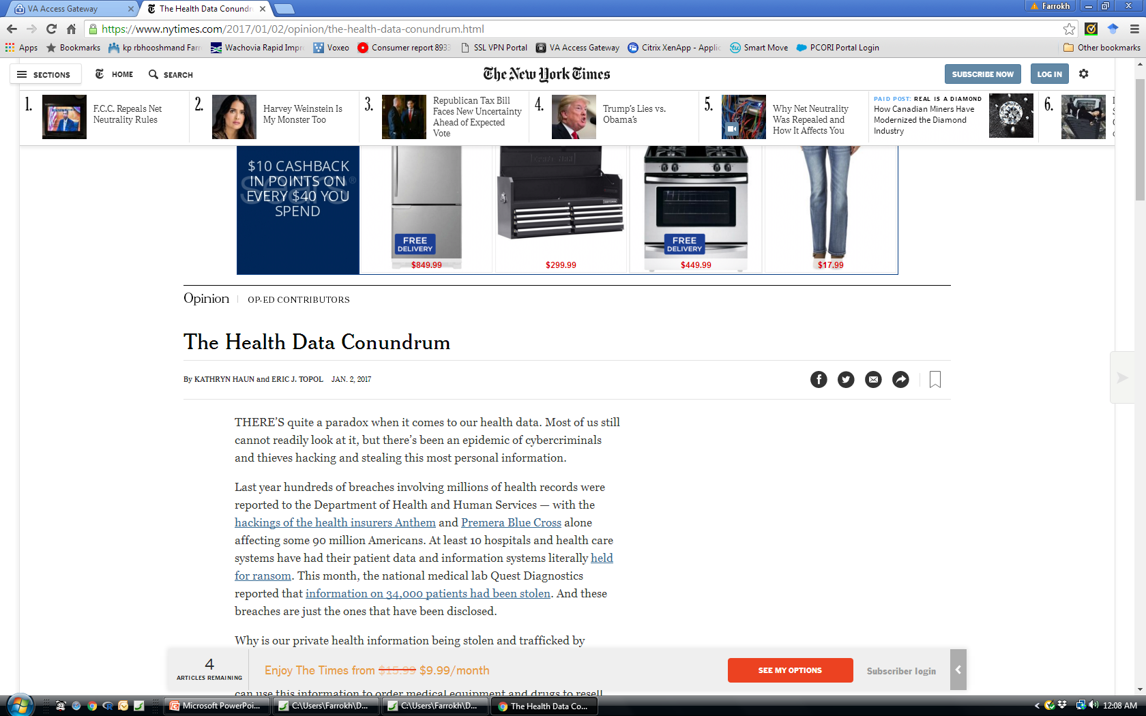



hacked
hacked
hacked

Slide 8


Why?
Patient
Clinician
Some Vendors

Slide 9

Screen Entry & Review
Continuing Care Document
Vendor licenses allow access to data via
Ai

Slide 10

Not Software Re-engineering

Slide 11
Legitimate Consented Access

Slide 12
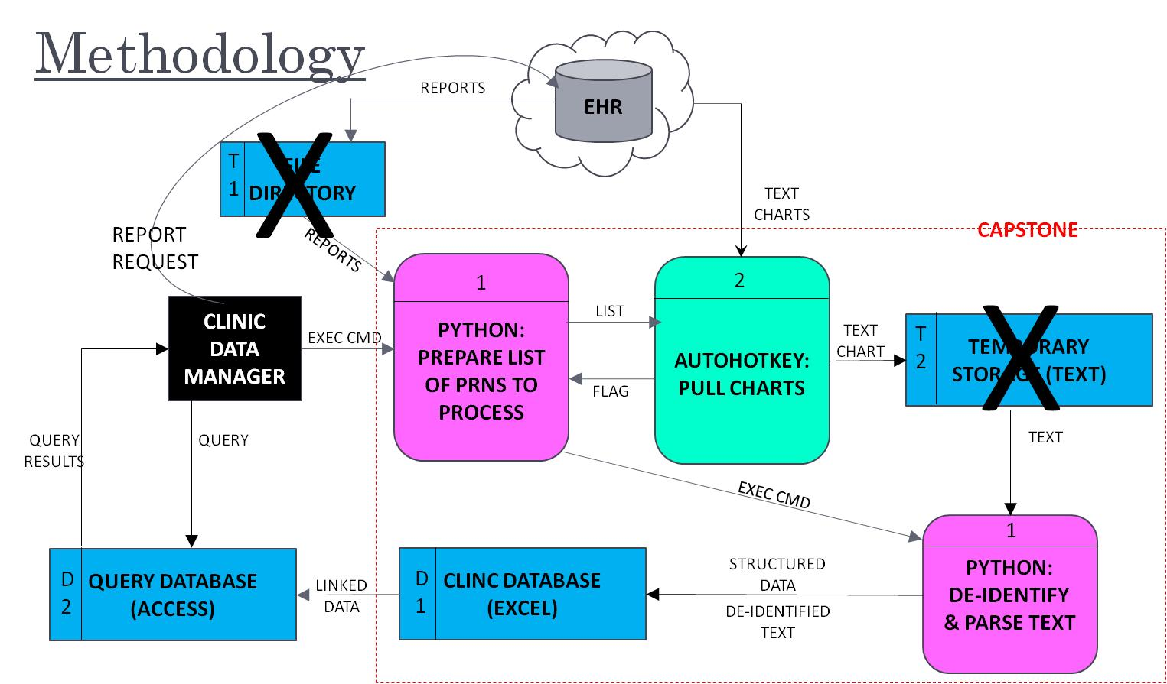

Slide 13
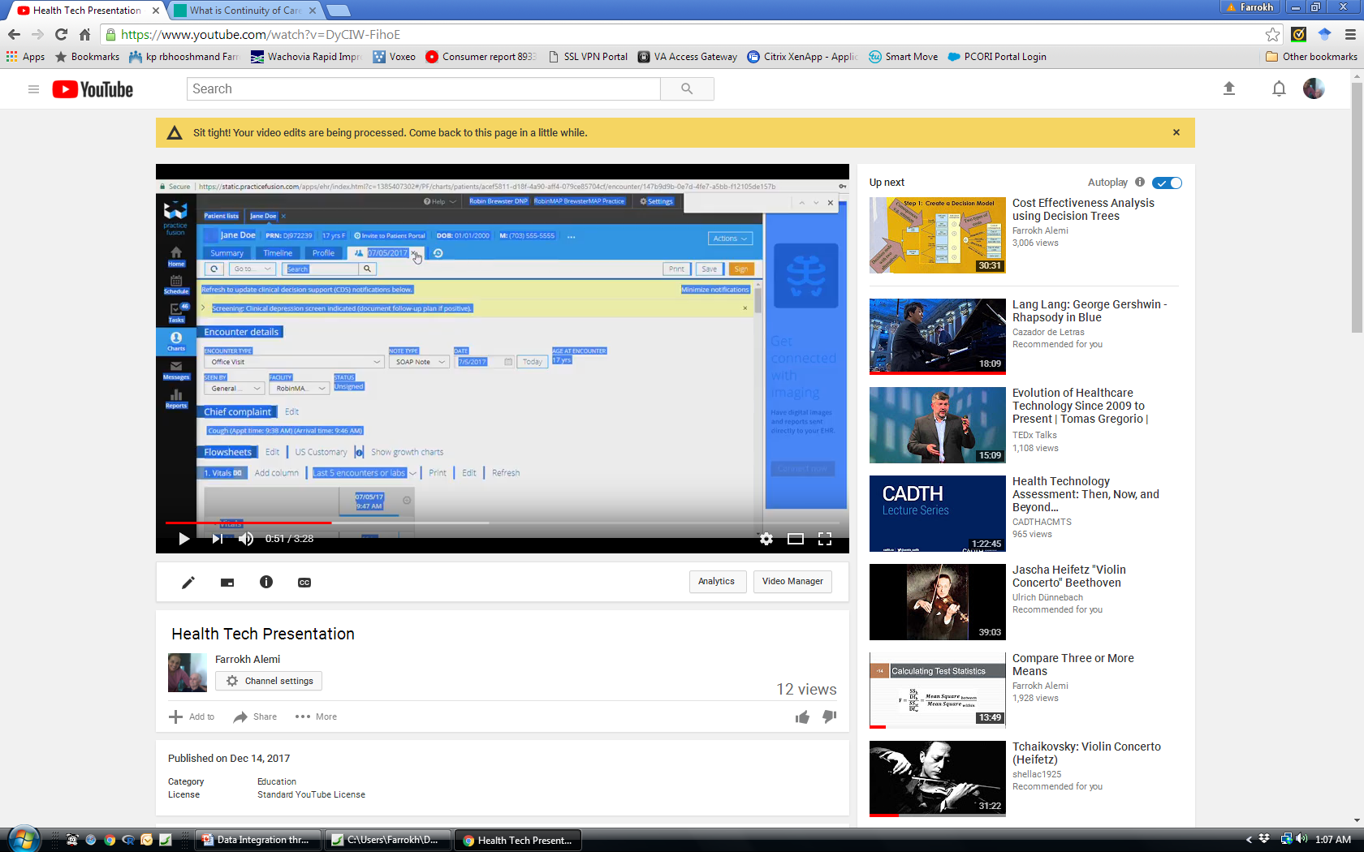
Not Real
First
Next
Last

Slide 14


What Can Help More?
Regulations?
New technologies?
  Public domain tools
  Wide availability of the tool
  A.I. recognition of data elements in CCD
  Automated organization of auto hot key

Slide 15
Hackers Integrate Data
Take Home Lesson

